Slide 1

Embedded System and it’s Applications
Tapan K. Gandhi, EE
Notes:
https://www.axiscades.com/5-technological-advancements-in-embedded-solutions-and-systems.html

Slide 2
Embedded system:
Any device that includes a computer but is not itself a general-purpose computer.
Part of some larger systems and expected to function without intervention.
Respond, Monitor, Control external environment using sensors and actuators.
Notes:
PROCESSOR, BUS STRUCTURE, INTERFACING ISSUES
SOFTWARE OPTIMISATION OF THE PROGRAM AND REALTIME OS ISSUES
EXAMINE DIFFERNT ASPECTS OF NETWORK EMBEDED SYSTEM

Slide 3
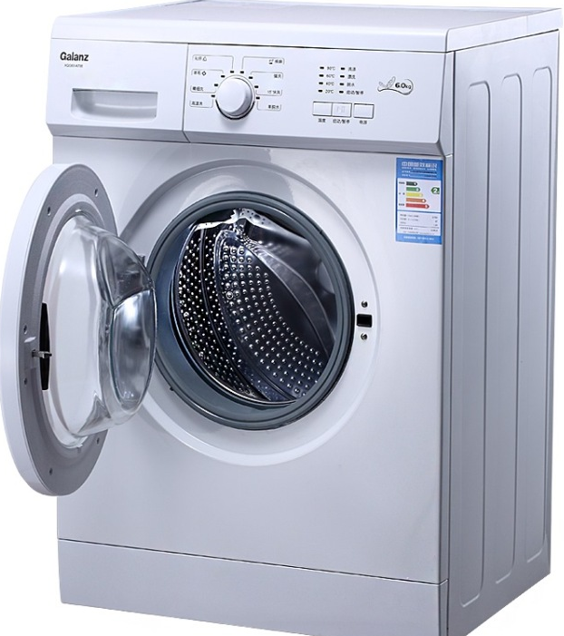
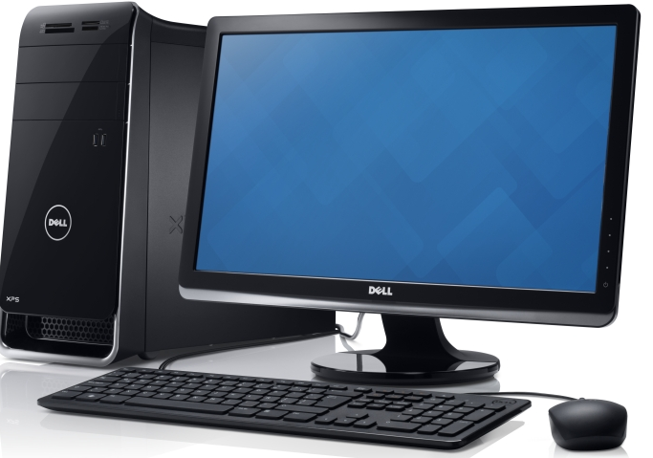

Slide 4
In a nutshell….
Embedded system is a combination of hardware and software.
Embedded system is a part of a larger system.
Embedded system is used to perform a particular task.
Small in size
Low power
Low cost
Computer
Examples: ATM Machines, Smart Phones, Gaming consol, Router, Engine Controller

Slide 5
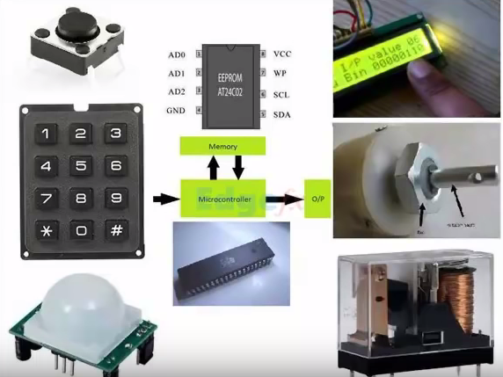
Notes:
8051
Machine language (hex code)

Slide 6
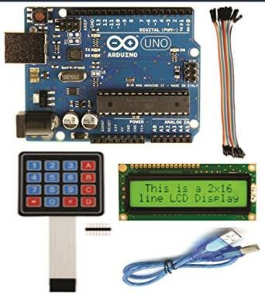
Notes:
Arduino Uno, Leonardo, Due, Micro, LilyPad Arduino, Esplora, Yun, and Robot

Slide 7
The End Goal of the Course
Interface a microcontroller to a variety of analog and digital input and output devices.
Program a microcontroller to implement a closed to automatic control.
Write and troubleshoot assembly language code for a microcontroller.
Analyze problems to determine the appropriate microcontroller use.

Slide 8
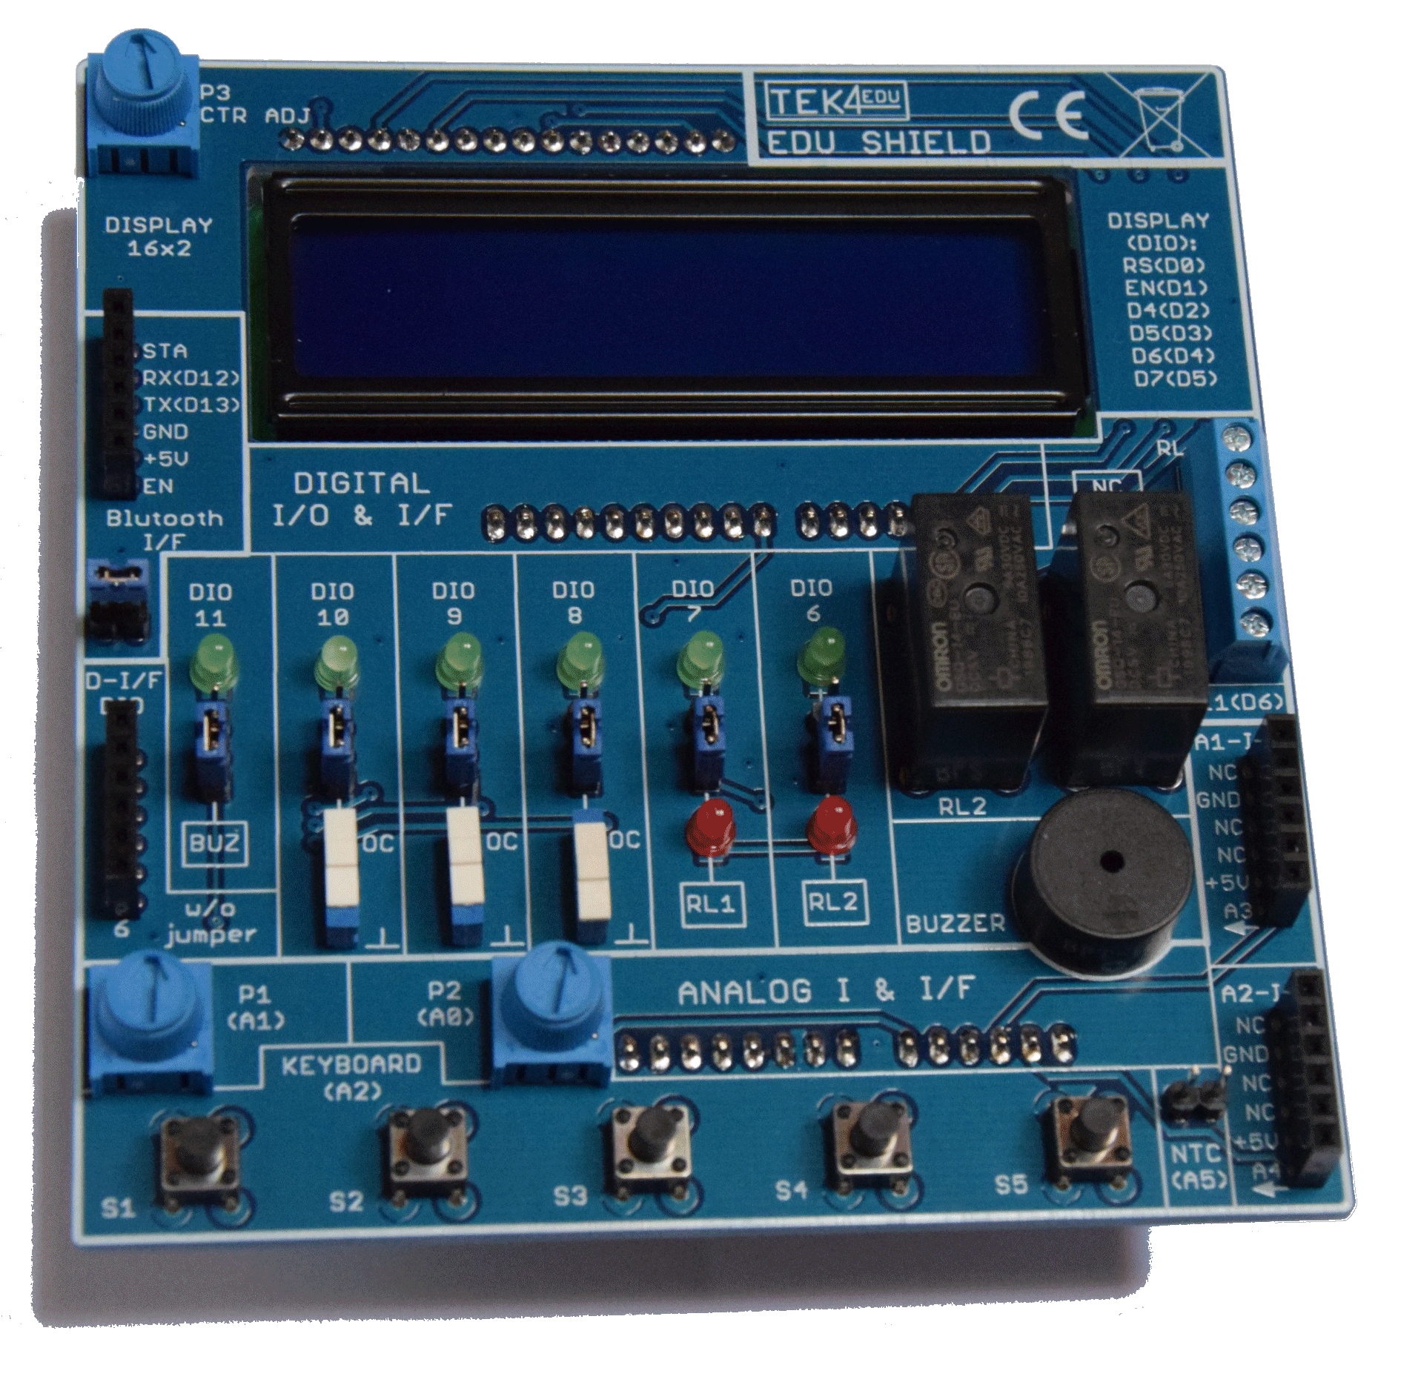
Edushield

Slide 9
What is an Embedded System?
The integration of
Sensors
Actuators
Intelligence (%)
To Produce a system
- More capable, Versatile and Robust Performance

Slide 10
Correct tool (Microcontroller) to use
is a correct tool to use;
Intelligence is required in the system
The complexity of a system is reduced
The cost of the microcontroller is less than using discrete components to perform the desired job.
A variety and bunch of sensors and actuators associated with any system.
Device to device communication

Slide 11
Not the correct tool (Microcontroller) to use
The system requires little or no intelligence
The system can be made easier and/or cheaper using discrete components.
The microcontroller is undersized for the problem…
Too slow
Too much number crunching required
Too many things going on

Slide 12
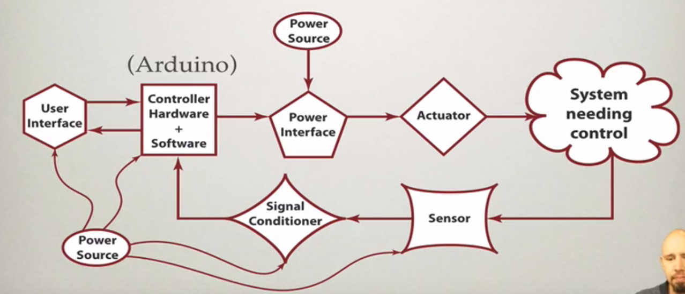

Concept Note of Embedded System

Slide 13
System Needing Control
Electrical
Mechanical
Electro-Mechanical (Mechatronics)
Biological
Thermodynamics
Bio-mechanical
Chemical etc.

Slide 14
User Interface
Takes inputs from user
Provide meaningful information to the user
Could be a:
-GUI
-Numerical Readout
-Warning Indicator
etc.

Slide 15
Controller Hardware
Computer (analog/digital)
Microcontroller
Communication circuit
Other devices of UI
Interface Circuitry
Pullup/Pulldown resistors
Analog Processing

Slide 16
Controller Software
C/C++/Arduino IDE for many functions
Assembly language for higher speed functions
FPGA for highest speed (VHDL)

Slide 17
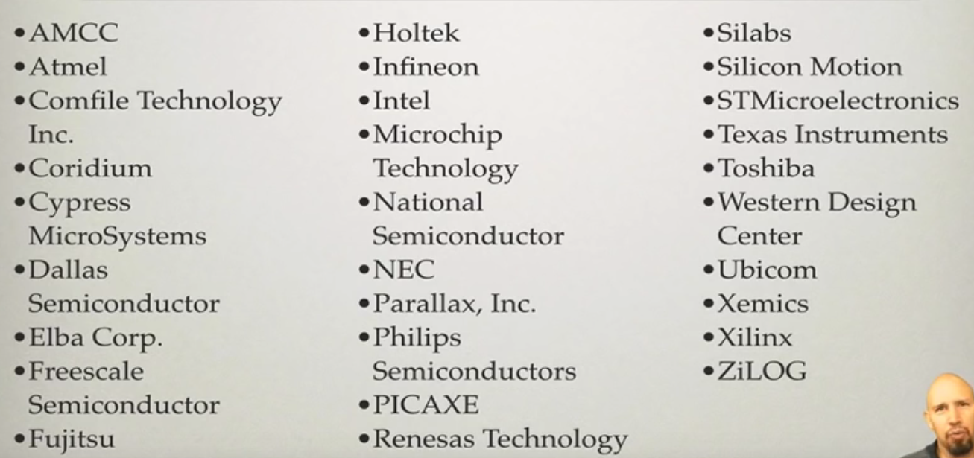
Microcontroller Manufacturer
Notes:
Y2K Problem

Slide 18
Why Arduino?
Improvement over other micro-controller for hobby usage
Inexpensive
IDE on multiple platforms (Mac, PC, Linux)
Simple, clear Programming environment: C
Open source and extensible software/hardware
Arduino Shields

Slide 19
Arduino Shields
Shields
Shields are boards that can be plugged on top of the Arduino PCB extending its capabilities. The different shields follow the same philosophy as the original toolkit: they are easy to mount, and cheap to produce.
Xbee
The Arduino Xbee shield allows multiple Arduino boards to communicate wirelessly over distances up to 100 feet (indoors) or 300 feet (outdoors) using the Maxstream Xbee Zigbee module.
Motor Control v1.1
The Arduino Motor shield allows you to control DC motors and read encoders.
More Shields are…..

Slide 20
Arduino Shields
VGA Camera
GPS
LCD/LED Display
Ethernet
WiFi
Motor Control (stepper, dc)
Accelerometer/Gyroscope
Relays etc.

Slide 21
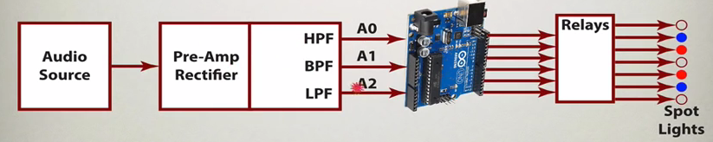
Application of Arduino
Light dimmer that responds to music

Slide 22
Piano gloves
https://www.youtube.com/watch?v=t5L8KDfNENo

Slide 23

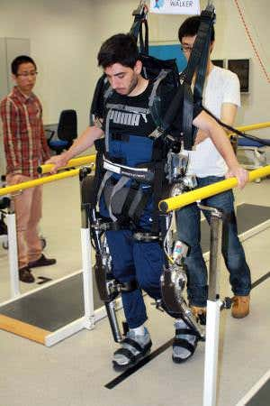
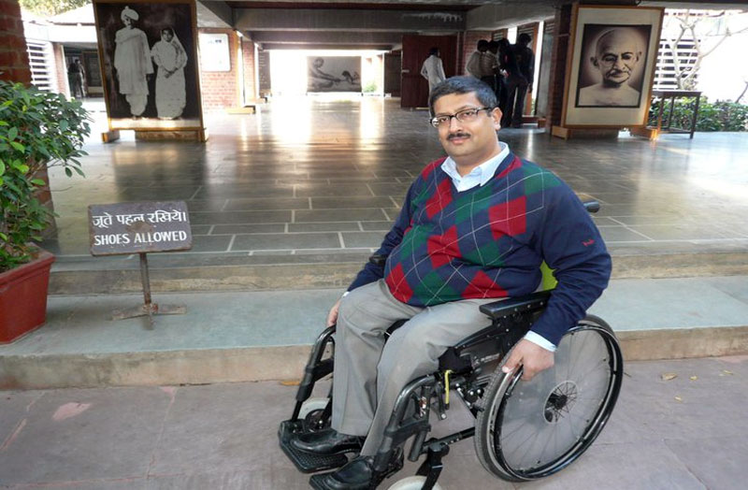

Slide 24
